Slide 1
Skills Bootcamp Classroom Rules
Be on time: Just like in a physical classroom, it's important to be punctual for your online class. Log in to the virtual classroom a few minutes before the class starts.
Turn Cameras on: In order to maximise your learning studies show that being able to see your peers and your tutor being able to see you can increase motivations and retention, therefore we ask to keep your cameras on.
Attend all classes: In order to be successful in your bootcamp studies you need to attend all live sessions, therefore you should prioritise and make time for these sessions.
Avoid distractions: Turn off your phone notifications, close any other unnecessary tabs, and focus solely on the class.
Participate actively: It's important to be an active participant in the class. Ask questions, answer questions, and participate in discussions.
Use proper language and tone: Use respectful language and tone when communicating with your classmates and instructor. Avoid using slang or inappropriate language.
Respect others' opinions: Be respectful of others' opinions, even if they differ from your own. Avoid making negative comments or attacking others.
Follow the instructor's guidelines: Follow the instructor's guidelines, such as submitting assignments on time.
Be polite: Be polite and respectful to everyone in the class, including the instructor, classmates, and guest speakers.
Dress appropriately: Even though you are not in a physical classroom, it's important to dress appropriately. Dress as if you were going to a face-to-face class.
Use appropriate technology: Ensure that you have the necessary equipment, such as a reliable internet connection, a microphone, and a webcam, and that they are in good working condition.

Slide 2
Software Developer Bootcamp
Unit 1 – Introduction to Software Development
Week 1A
Notes:
Good morning/afternoon everyone. Today we'll delve into the role of software in various industries, understand their primary purposes, and classify them based on their target audiences.

Slide 3
Objectives
Describe What SOFTWARE is, and What SOFTWARE DEVELOPMENT is.
Describe the major TYPES of software.
Overview of Software in Industries
Classification: B2B vs. B2C
Describe the roles within the software development teams and the tasks they perform
Notes:
Here's a brief overview of our objectives for today. We have a lot to cover, so let's get started.

Slide 4

What is SOFTWARE?
What is HARDWARE?
Notes:
https://www.plm.automation.siemens.com/global/en/industries/software-development/

Slide 5
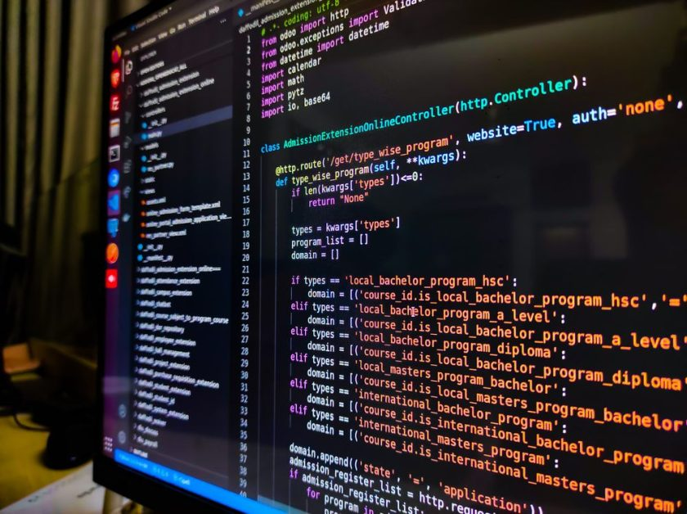
What is SOFTWARE?
SOFTWARE & HARDWARE
We humans give instructions to computers to make them perform certain tasks.
We call these instructions CODE.
A set of coded instructions that performs a particular purpose or function is called a PROGRAM.
SOFTWARE is simply the term for a collection of programs - although many people use the term interchangeably with PROGRAM.
Notes:
https://geekflare.com/software-engineering-courses/

Slide 6

What is Software and Hardware?
Notes:
https://geekflare.com/software-engineering-courses/

Slide 7
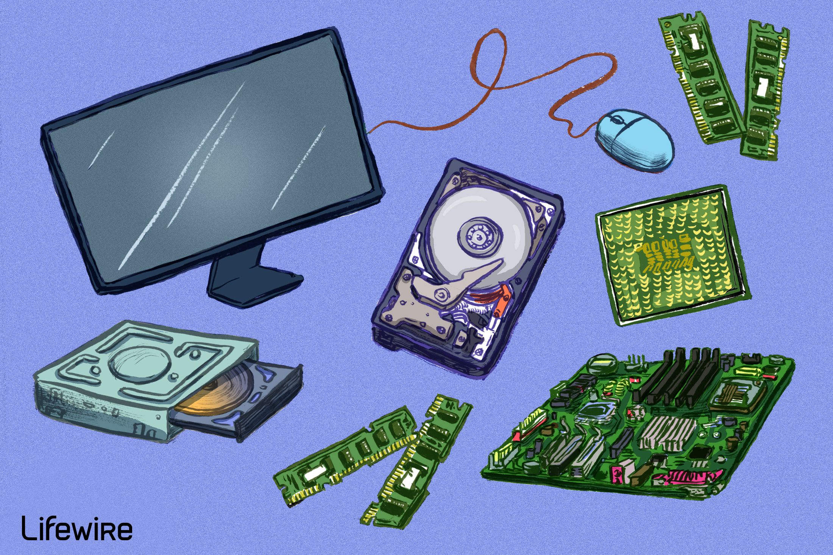
What is HARDWARE?
SOFTWARE & HARDWARE
Computer HARDWARE is the physical components that make up your computer – such as the processor, RAM, hard drive, graphics cards.
The job of the hardware is to execute the software code. i.e. carry out the software instructions.
Notes:
https://www.lifewire.com/computer-hardware-2625895

Slide 8
What is SOFTWARE DEVELOPMENT?
Notes:
https://www.plm.automation.siemens.com/global/en/industries/software-development/

Slide 9
What is SOFTWARE DEVELOPMENT?
SOFTWARE DEVELOPMENT is the process and set of activities used to create software.
The process of creating software involves several different steps, such as design and testing.
A SOFTWARE DEVELOPER is the person who writes the software code.
However, software development involves more steps and more people than this! You will learn about these shortly.
Extra Reading: https://www.ibm.com/uk-en/topics/software-development

Slide 10
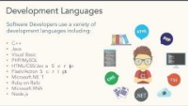
What is Software Development?
Notes:
https://geekflare.com/software-engineering-courses/

Slide 11
TYPES OF SOFTWARE

Slide 12
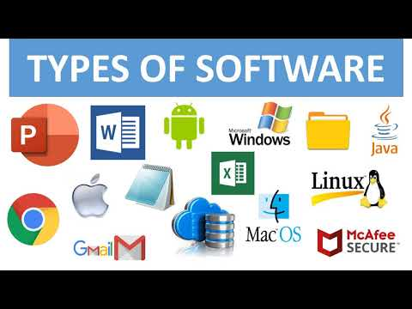
TYPES of SOFTWARE
TYPES of SOFTWARE
Software programs can normally be put into two main categories:
SYSTEM SOFTWARE
APPLICATION SOFTWARE
Depending on what source you read, you may also see additional software types such as UTILITY SOFTWARE and DEVELOPMENT SOFTWARE, but these are really sub-types of SYSTEM and APPLICATION software.
Notes:
https://i.ytimg.com/vi/BTB86HeZVwk/hqdefault.jpg

Slide 13
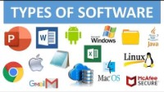
Types of Software?
Notes:
https://geekflare.com/software-engineering-courses/

Slide 14
SYSTEM SOFTWARE
TYPES of SOFTWARE
SYSTEM SOFTWARE is the software that runs the computer hardware. It can control the interaction between you (the USER) and the hardware.
System Software often does things automatically in the background.
Examples of System Software include:
Operating Systems (OS) - E.g. Windows, Linux, Android
Drivers (specific software that allows your OS to work with your hardware)
Utility Software – such as anti-virus, file managers/explorers, computer settings
System Software also provides a platform on which to install APPLICATION SOFTWARE…

Slide 15
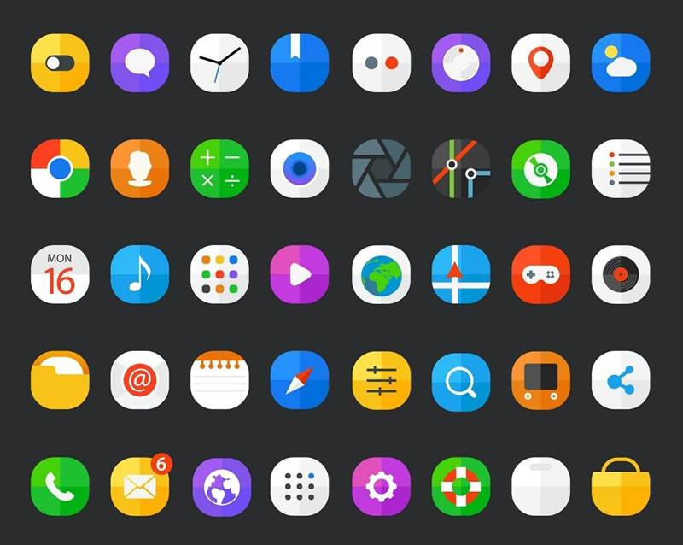
APPLICATION SOFTWARE
TYPES of SOFTWARE
APPLICATION SOFTWARE is installed on top of System Software.
Application Software is software that the user directly interacts with to perform useful tasks/functions.
Many people now call them ‘apps’.
There are many types of Application Software, here are just some example types:
Office software
Web Browser
Multimedia software
Games
Coding/Development Software (IDEs)
Notes:
https://www.techopedia.com/2/28350/personal-tech/software-applications/an-introduction-to-application-software

Slide 16
Why is Software Pervasive?
Modern-day demands: Increase in online activities
Automating processes: From manufacturing to customer service
Enhanced user experience: Personalisation and accessibility
Notes:
In today's digital age, software has become indispensable for various reasons….

Slide 17
Industries Heavily Relying on Software
Banking & Finance: Core to transactional activities
Healthcare: Enables telemedicine and data analytics
Retail: Drives both online and in-store experiences
Notes:
Today we'll focus on Banking & Finance, Healthcare, and Retail, examining the types of software prevalent in these industries.

Slide 18

Why Software?
Notes:
https://geekflare.com/software-engineering-courses/

Slide 19
Group Activity (10 mins)
As a group, brainstorm other industries where software plays a critical role. Provide examples of specific software used in those industries.
Notes:
Today we'll focus on Banking & Finance, Healthcare, and Retail, examining the types of software prevalent in these industries.

Slide 20

Banking & Finance
Banking & Finance: The primary purpose is to provide a secure and efficient means of conducting financial transactions. Example software: Digital banking apps.
Healthcare: The software aims to improve patient care through better data management and remote consultations. Example software: Electronic Health Records (EHR).
Retail: Enhancing customer experience is the focal point, whether it's online shopping or in-store interactions. Example software: E-commerce platforms.
Algorithmic trading: Real-time, automated trading decisions
Customer service platforms: AI chatbots, FAQs
Digital banking apps: Mobile payments, account management
Notes:
In the world of finance, software plays various roles….

Slide 21

Purpose of Software in Banking & Finance
Efficient transactions: Speeding up processes
Enhanced security: Encryption and firewalls
Personalised customer experience: Account customisation, notifications
Notes:
Let's delve into the purposes behind the use of software in the financial sector...

Slide 22

Software in Banking
Notes:
https://geekflare.com/software-engineering-courses/

Slide 23

Healthcare
Patient management systems: Scheduling, billing, and history
Telemedicine platforms: Video consultations, prescriptions
Medical imaging software: MRI, X-rays interpretation
Notes:
In healthcare, software aids in everything from administration to diagnostics.

Slide 24

Purpose of Software in Healthcare
Improved patient care: Accurate and timely diagnosis
Streamlined operations: Reducing admin time
Data-driven decisions: Analytics for patient outcome
Notes:
In healthcare, software is not just a tool but a catalyst for better patient care...

Slide 25

Software in Health Care
Notes:
https://geekflare.com/software-engineering-courses/

Slide 26
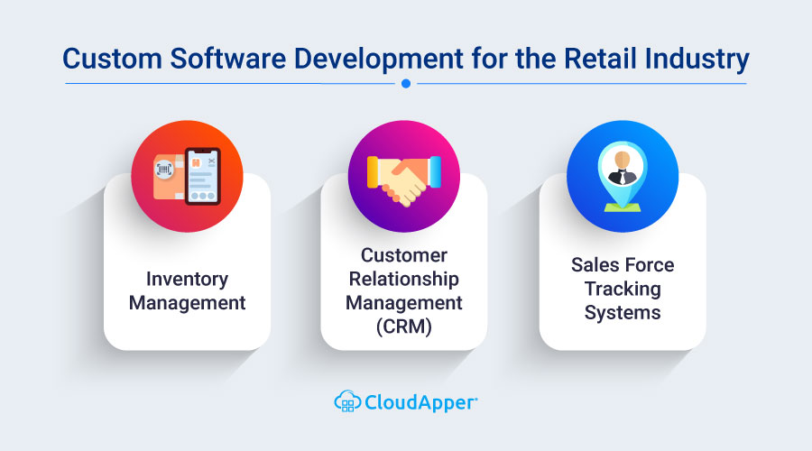
Retail
E-commerce platforms: Online shopping portals
Inventory management systems: Real-time stock updates
Customer relationship management (CRM): Customer data and communication
Notes:
In retail, software is crucial for both back-end operations and front-end customer experiences...

Slide 27
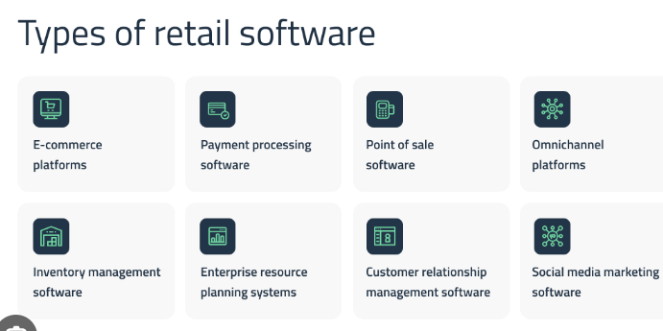
Purpose of Software in Retail
Enhanced shopping experience: User-friendly interfaces, quick checkouts
Efficient stock management: Automated reordering
Data-driven marketing: Personalised ads and promotions
Notes:
"A seamless shopping experience is just the tip of the iceberg when it comes to retail software...

Slide 28

Software in Retail
Notes:
https://geekflare.com/software-engineering-courses/

Slide 29
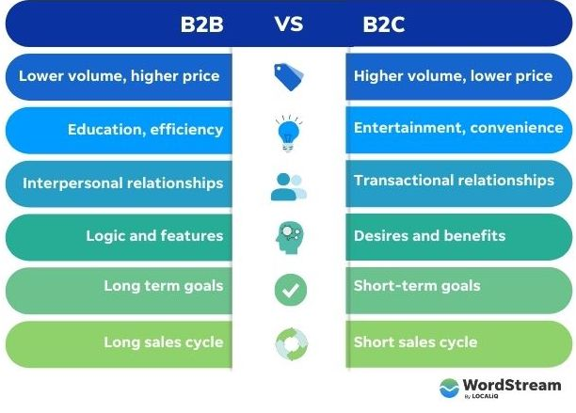
Classification – B2B vs. B2C
Definition: B2B (Business-to-Business): Software aimed at enterprise solutions
Definition: B2C (Business-to-Consumer): Software designed for end-users
Notes:
Understanding the differences between B2B and B2C software is crucial for both development and marketing...

Slide 30

Software in Banking - B2B or B2C?
Digital banking apps: B2C – User-facing apps for daily banking
Algorithmic trading platforms: B2B – Used by financial institutions
Notes:
In the banking sector, both B2B and B2C software coexist, serving different functions...

Slide 31
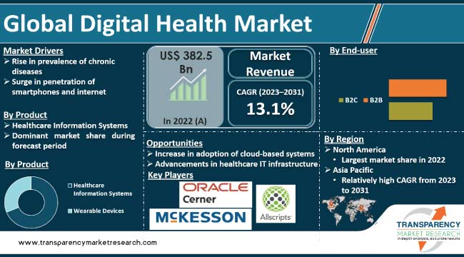
Software in Healthcare - B2B or B2C?
Telemedicine platforms: B2C – Direct consultations with patients
Medical imaging software: B2B – Used by healthcare providers for diagnostics
Notes:
Healthcare software serves both individual patients and larger healthcare organisations...

Slide 32
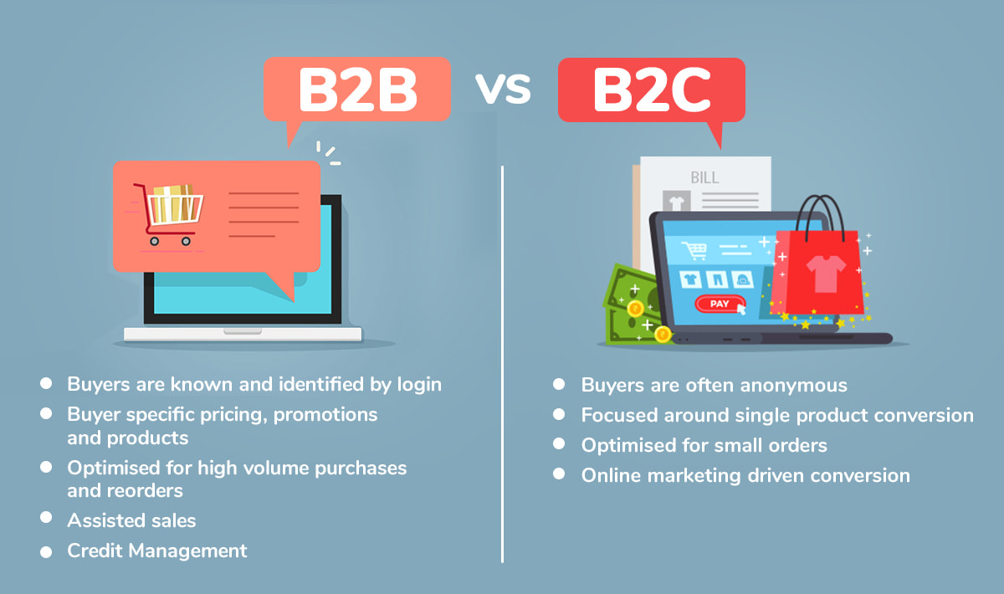
Software in Retail - B2B or B2C?
E-commerce platforms: B2C – Direct-to-customer sales portals
Inventory management systems: B2B – Used for stock control by retailers
Notes:
Online shopping is a classic B2C model, while inventory systems typically fall under B2B...

Slide 33
Group Activity
Each group will pick one real-world case study involving software from either Banking and finance, Healthcare, or Retail. Discuss and identify whether the software involved is B2B or B2C, and prepare to share your analysis with the class.
Notes:
Time for a group activity. Each group should identify more software examples in these industries and classify them as B2B or B2C.

Slide 34
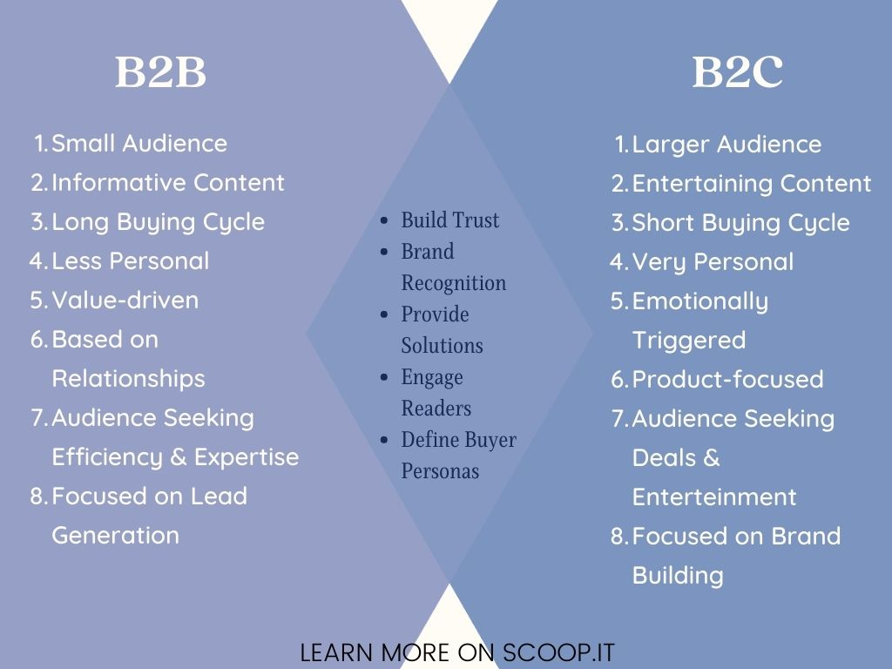
Importance of Classification
Target Audience Understanding: Tailoring functionalities
Design & Features Variability: UI/UX differences
Different Marketing Strategies: Customer segmentation and targeting
Notes:
Why does the classification matter? Let's delve into the implications for development and marketing...

Slide 35
Real-life Case Studies Research (10 mins)
Conduct research into these two case studies:
Case study 1: An e-commerce giant’s shift to B2B services. E.g., Amazon Web Services
Case study 2: A hospital’s adoption of B2C telemedicine platforms. E.g., Telehealth services during the pandemic
Notes:
These real-life examples will deepen our understanding of how software shapes industries.

Slide 36
Roles within Software Development Teams and the Tasks They Perform

Slide 37

Project Manager
Manages the project from start to finish
Sets deadlines and ensures tasks are completed on time
Communicates with stakeholders and team members
Makes sure the project is on budget

Slide 38

Software Architect
Designs the overall structure of the software
Creates the software architecture and design documents
Ensures the software meets the requirements of the project
Provides guidance to the development team

Slide 39

Software Developer
Writes the code for the software
Tests the software to ensure it meets the requirements
Fixes any bugs or issues that arise
Maintains the software after it is released

Slide 40

Software Tester
Tests the software to ensure it meets the requirements
Identifies any bugs or issues that arise
Creates test plans and test cases
Provides feedback to the development team

Slide 41

User Experience Designer
Designs the user interface of the software
Creates wireframes and mockups of the software
Ensures the software is easy to use and intuitive
Provides feedback to the development team

Slide 42

Technical Writer
Writes the documentation for the software
Creates user manuals and help documents
Ensures the documentation is accurate and up to date
Provides feedback to the development team

Slide 43

Database Administrator
Manages the database for the software
Creates and maintains the database structure
Ensures the database is secure and up to date
Provides feedback to the development team

Slide 44
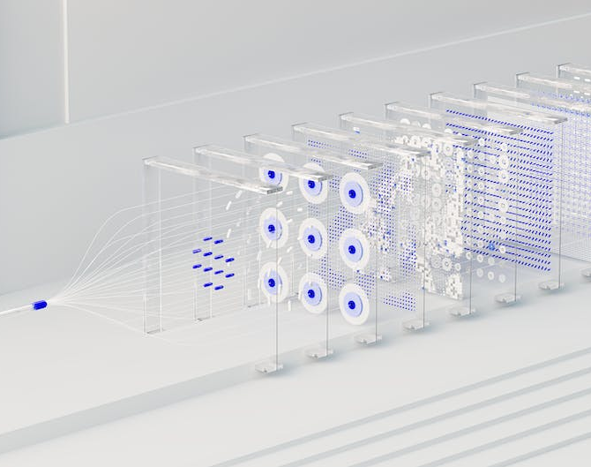
System Administrator
Maintains the system for the software
Installs and configures the software
Ensures the system is secure and up to date
Provides feedback to the development team
Notes:
Software development teams are powerful and can create amazing software
Each role within the team is important and has its own tasks to perform
By understanding the roles and tasks, teams can be more effective and successful

Slide 45
Group Activity: Who Wears What Hat? - A Software Development Team Simulation (15 mins)
Objective: To describe the roles within software development teams and the tasks they perform.
Instructions:
Each group represents a mini software development team.
Choose a Role: Roles include Developer, Project Manager, QA Engineer, DevOps, and Business Analyst.
Search for a case study: A real industry case study that involves software development.
Each group member reads the case study and discusses how they would contribute to solving the problem, strictly adhering to their assigned role.
Notes:
https://mobidev.biz/case-studies

Slide 46
Objectives
Describe What SOFTWARE is, and What SOFTWARE DEVELOPMENT is.
Describe the major TYPES of software.
Overview of Software in Industries
Classification: B2B vs. B2C
Describe the roles within the software development teams and the tasks they perform
Notes:
Here's a brief overview of our objectives for today. We have a lot to cover, so let's get started.

Slide 47

Questions?

Slide 48
Thank You

